Slide 1
Kerberos for Users
Jeff Blaine 5/2006

Slide 2
What is Kerberos?
Shared secret-based strong 3rd party authentication
Provides single sign-on capability
Passwords never sent across network
And now – the players…

Slide 3
Kerberos Requirements
its first report identified requirements as:
  secure
  reliable
  transparent
  scalable
implemented using an authentication protocol based on Needham-Schroeder
Notes:
The first published report on Kerberos [STEI88] listed the requirements shown above. To support these requirements, Kerberos is a trusted third-party authentication service that uses a protocol based on that proposed by Needham and Schroeder [NEED78], which was discussed in Chapter 7.

Slide 4
Kerberos v4 Overview
a basic third-party authentication scheme
have an Authentication Server (AS)
  users initially negotiate with AS to identify self
  AS provides a non-corruptible authentication credential (ticket granting ticket TGT)
have a Ticket Granting server (TGS)
  users subsequently request access to other services from TGS on basis of users TGT
Notes:
The core of Kerberos is the Authentication and Ticket Granting Servers – these are trusted by all users and servers and must be securely administered. The protocol includes a sequence of interactions between the client, AS, TGT and desired server.

Slide 5
Kerberos v4 Dialogue
obtain ticket granting ticket from AS
  once per session
obtain service granting ticket from TGT
  for each distinct service required
client/server exchange to obtain service
  on every service request
Notes:
The full Kerberos v4 authentication dialogue is shown in Stallings Table 14.1, divided into the 3 phases shown above. The justification for each item in the messages is given in Stallings Table 14.2.

Slide 6
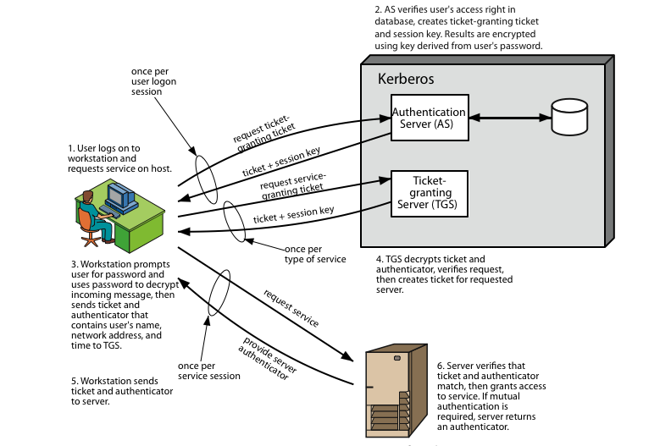
Kerberos 4 Overview
Notes:
Stallings Figure 14.1 diagrammatically summarizes the Kerberos v4 authentication dialogue, with 3 pairs of messages, for each phase listed previously.

Slide 7
Kerberos Realms
a Kerberos environment consists of:
  a Kerberos server
  a number of clients, all registered with server
  application servers, sharing keys with server
this is termed a realm
  typically a single administrative domain
if have multiple realms, their Kerberos servers must share keys and trust
Notes:
A full-service Kerberos environment consisting of a Kerberos server, a number of clients, and a number of application servers is referred to as a Kerberos realm. A Kerberos realm is a set of managed nodes that share the same Kerberos database, and are part of the same administrative domain. If have multiple realms, their Kerberos servers must share keys and trust each other.

Slide 8
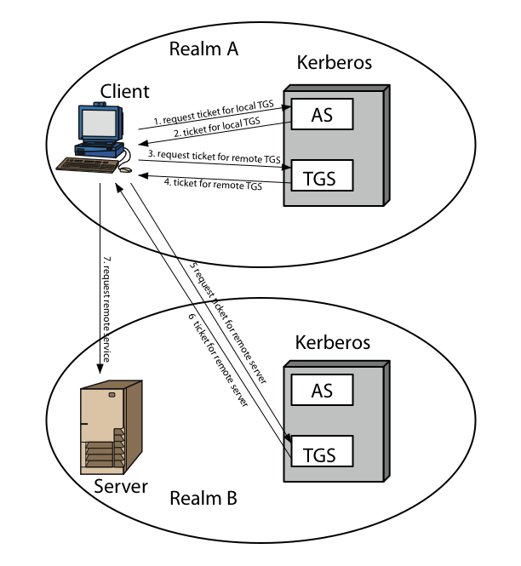
Kerberos Realms
Notes:
Stallings Figure 14.2 shows the authentication messages where service is being requested from another domain. The ticket presented to the remote server indicates the realm in which the user was originally authenticated. The server chooses whether to honor the remote request. One problem presented by the foregoing approach is that it does not scale well to many realms, as each pair of realms need to share a key.

Slide 9
Kerberos Version 5
developed in mid 1990’s
specified as Internet standard RFC 1510
provides improvements over v4
  addresses environmental shortcomings
    encryption alg, network protocol, byte order, ticket lifetime, authentication forwarding, interrealm auth
  and technical deficiencies
    double encryption, non-std mode of use, session keys, password attacks
Notes:
Kerberos Version 5 is specified in RFC 1510 and provides a number of improvements over version 4 in the areas of environmental shortcomings and technical deficiencies, in areas as noted. See Stallings Table 14.3 for details of the Kerberos v5 authentication dialogue.

Slide 10
XYZ Service
Key
Distribution
Center
Ticket
Granting
Service
Think “Kerberos Server”
Authen-
Tication
Service
Susan’s
Desktop
Computer
Susan

Slide 11
XYZ Service
Key
Distribution
Center
Ticket
Granting
Service
Represents something requiring Kerberos authentication (web server, ftp server, ssh server, etc…)
Authen-
Tication
Service
Susan’s
Desktop
Computer
Susan

Slide 12
XYZ Service
Key
Distribution
Center
Ticket
Granting
Service
“I’d like to be allowed to get tickets from the Ticket Granting Server, please.
Authen-
Tication
Service
Susan’s
Desktop
Computer
Susan

Slide 13

XYZ Service
Key
Distribution
Center
Ticket
Granting
Service
“Okay. I locked this box with your secret password. If you can unlock it, you can use its contents to access my Ticket Granting Service.”
Authen-
Tication
Service
Susan’s
Desktop
Computer
Susan

Slide 14

XYZ Service
Key
Distribution
Center
Ticket
Granting
Service
Authen-
Tication
Service
Susan’s
Desktop
Computer
TGT
myPassword
Susan

Slide 15
Because Susan was able to open the box (decrypt a message) from the Authentication Service, she is now the owner of a shiny “Ticket-Granting Ticket”.
The Ticket-Granting Ticket (TGT) must be presented to the Ticket Granting Service in order to acquire “service tickets” for use with services requiring Kerberos authentication.
The TGT contains no password information.
TGT

Slide 16
XYZ Service
“Let me prove I am Susan to XYZ Service.
Here’s a copy of my TGT!”
Key
Distribution
Center
Ticket
Granting
Service
Authen-
Tication
Service
TGT
TGT
Susan’s
Desktop
Computer
use XYZ
Susan

Slide 17
XYZ Service
Hey XYZ:
Susan is Susan.
CONFIRMED: TGS
Key
Distribution
Center
Ticket
Granting
Service
You’re Susan.
Here, take this.
Authen-
Tication
Service
TGT
Susan’s
Desktop
Computer
Susan

Slide 18
XYZ Service
Key
Distribution
Center
Ticket
Granting
Service
I’m Susan. I’ll prove it. Here’s a copy of my legit service ticket for XYZ.
Authen-
Tication
Service
Hey XYZ:
Susan is Susan.
CONFIRMED: TGS
Hey XYZ:
Susan is Susan.
CONFIRMED: TGS
TGT
Susan’s
Desktop
Computer
Susan

Slide 19
XYZ Service
That’s Susan alright. Let me determine if she is authorized to use me.
Key
Distribution
Center
Ticket
Granting
Service
Hey XYZ:
Susan is Susan.
CONFIRMED: TGS
Authen-
Tication
Service
Hey XYZ:
Susan is Susan.
CONFIRMED: TGS
TGT
Susan’s
Desktop
Computer
Susan

Slide 20
Authorization checks are performed by the XYZ service…
Just because Susan has authenticated herself does not inherently mean she is authorized to make use of the XYZ service.

Slide 21
One remaining note:
Tickets (your TGT as well as service-specific tickets) have expiration dates configured by your local system administrator(s). An expired ticket is unusable.
Until a ticket’s expiration, it may be used repeatedly.

Slide 22
XYZ Service
Key
Distribution
Center
Ticket
Granting
Service
ME AGAIN! I’ll prove it. Here’s another copy of my legit service ticket for XYZ.
Authen-
Tication
Service
Hey XYZ:
Susan is Susan.
CONFIRMED: TGS
Hey XYZ:
Susan is Susan.
CONFIRMED: TGS
TGT
Susan’s
Desktop
Computer
use XYZ
Susan

Slide 23
XYZ Service
That’s Susan… again. Let me determine if she is authorized to use me.
Key
Distribution
Center
Ticket
Granting
Service
Hey XYZ:
Susan is Susan.
CONFIRMED: TGS
Authen-
Tication
Service
Hey XYZ:
Susan is Susan.
CONFIRMED: TGS
TGT
Susan’s
Desktop
Computer
Susan

